Slide 1

Transforming Instruction
Julie Tomczak

Slide 2
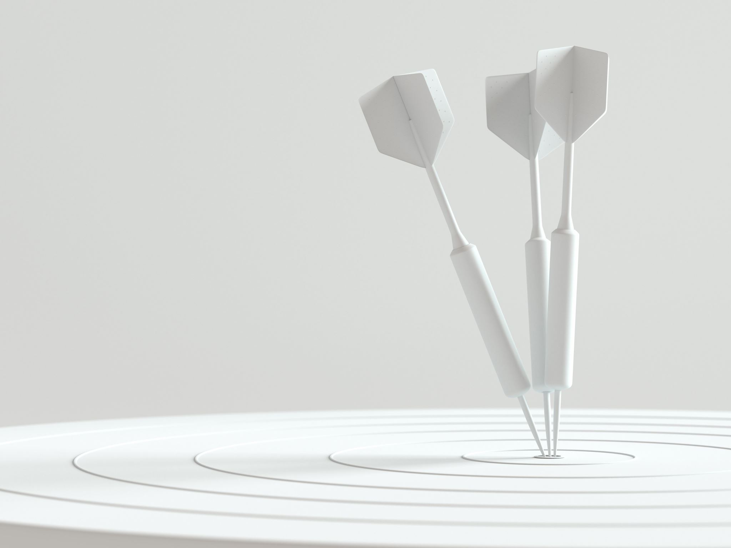
Goals:
Teachers will be equipped with a variety of strategies to enhance student engagement in an online or hybrid setting.
Teachers will have opportunities to practice using student engagement strategies with other middle school teachers.
Notes:
Instructor will discuss how these goals have been shared as identified needs from staff and administration. Both goals will be covered throughout a series of lessons and work time will be done within grade level or subject area.

Slide 3
Connecting the Dots
Engagement Strategies
Notes:
Let’s think back to your foundational strategies you know and love to use in your everyday instruction. Try to think of at least 2-3 examples of active strategies that come to your head and consider why you routinely use them in your classroom.

Slide 4
Current Reality
Small Group Discussion
  What are your favorite active engagement strategies?
  Why do these strategies work well for you?
  What strategies would you like to carry over to online instruction?
Notes:
Today we will begin by discussing the use of active engagement strategies in an in-person learning environment. Try to think of at least 2-3 examples of active strategies that come to your head before discussing with your group. Jot down your ideas on a sticky note so you are ready to share with your group members.

Slide 5


Group Discussion
Staff Padlet
Notes:
Now let’s bring together your ideas and find out how the group responses were similar or different. Under each question, type your group’s shared answers. Then, look through other group answers and provide feedback or “hearts” for different things you agree with in the responses.

Slide 6
Breakout Rooms
Discussion Boards
Guided & Student-led lessons
Self-Evaluation
Online Engagement
Notes:
Now we are going to dive into some online engagement strategies that could be useful for your everyday instruction. The tools and strategies discussed here are broken down into four sections. Each of these sections will be covered in detail through examples, and you will have the opportunity to act as a student and test out the tool with a learner’s lens.

Slide 7
Group Discussion
Staff Padlet
Notes:
Now let’s bring together your ideas and find out how the group responses were similar or different. Under each question, type your group’s shared answers. Then, look through other group answers and provide feedback or “hearts” for different things you agree with in the responses.

Slide 8
Comparing Engagement Strategies
In-person strategies
Online strategies
Small Group Goals
  Have all members join the group Jamboard
  Discuss strategies that are similar or different between online and in-person
  Consider how strategies can be transformed to fit a new setting!
Notes:
Now you are going to create a group Venn Diagram comparing the two different formats of instruction (in-person vs online) and you will break down the strategies trying to considered what is similar and what is different between the two formats. Create a group Venn Diagram on Jamboard and be prepared to share with the whole group!

Slide 9
Making Connections
In-person
Think, pair, share
Gallery walk
In/out circle
Breakout rooms
Pear Deck
Jamboard/ Padlet
Zoom Chat + Polls
Four corners
Jigsaw
Choral response
Simulations
Online
Zoom annotations
Self-evaluation
Partner/ Group work
Guided instruction
Student-led instruction
Notes:
Venn Diagram will be empty during training. The instructor will collect ideas and add them to the shared Venn Diagram while teachers give examples or ideas as a whole staff. The key is to recognize the patterns across both instructional formats and identifying how they look using in-person or online instruction.

Slide 10
Classroom Application
Lesson Design & Implementation
Notes:
Our next step is to provide you with time to design a lesson using one of the tools or strategies shared today. Try to think of something small (individual lesson – not whole unit) to create.

Slide 11

Lesson Design Groups
Group 1: Breakout Rooms
Group 2: Padlet
Group 3: Jamboard
Group 4: Zoom Chats
Group 5: Pear Deck
Group 6: NearPod
Group 7: Student self-evaluation
Notes:
For this first portion, you will be asked to join a breakout room based on the tool you plan to use for your lesson. Please look through the list and decide what tool/ strategy you will be using, and join that breakout room. While you are working, share tips/ ideas with your group members (but do not share your lesson).

Slide 12


Lesson Practice
Teachers will be split up by grade level or subject area groups.
In these groups, teachers will…
Teach their lesson to colleagues
Act as students in mini-lessons
Provide feedback on lessons and tool use
Notes:
Let’s practice! It is time to try out your lesson using your new tool/ strategy. You will be split up by grade level or subject area depending on what suits your needs. In these groups, please take turns teaching lessons, acting as “students,” and providing feedback on instruction.

Slide 13
Questions?
Notes:
After you had a chance to explore, create, and practice, what questions do you have about the training or strategies shared today?

Slide 14
Feedback
Please fill out the feedback form provided to help us improve our trainings and better support you in the future!
Notes:
Consider:
What was helpful today?
What was not helpful today?
What were you hoping to learn that was not covered?
What do you still need after learning strategies today?

